Slide 1

TESLA Stock Analysis
Karine Piccoli
Sashi Devulapalli

Slide 2
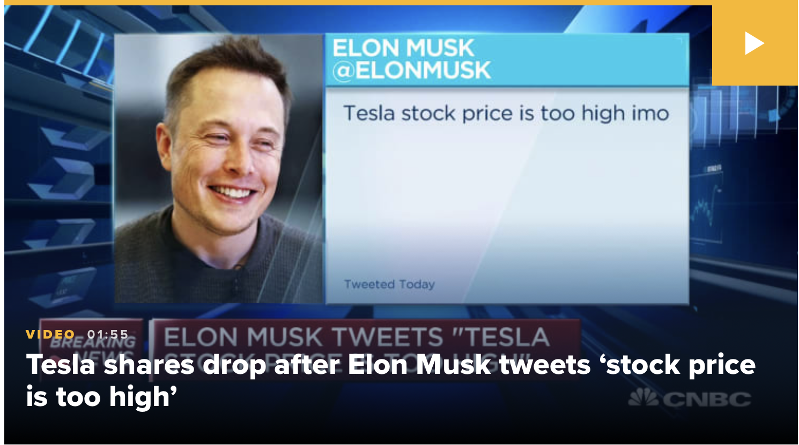
Tesla Background
Tesla is an American electric vehicle and clean energy company based in Palo Alto, CA.
It is specialized in electric vehicles manufacturing among other things.
Tesla shares have outperformed other major tech and auto stocks since it went public 10 years ago.
The stock has had plenty of ups and downs along the way.
But shares have rallied this year since the company’s new factory came online.
On Aug. 28, Tesla will split its sock for the first time.
Tesla is now gunning for inclusion in the S&P500.

Slide 3

Project Purpose
Project Purpose:
Analyze Tesla Stock
Predict the Stock Price Using Machine
Learning Algorithms
Language/Tools:
Python
Pandas
NumPy
Scikit-Learn
Matplotlib
Seaborn
Tableau

Slide 4

Approach
Web Scraping Tesla Stock News Information
Note: Not significant data to perform our analysis.
Obtained Historical Stock Price from Yahoo Finance
Correlation Between Volume Traded vs. Close Price
Price Distribution and Rolling Mean Average
Leveraged Machine Learning Algorithms and Analyzed the Stock
Utilized Tableau and provide an overview of the stock trend using candle stick analysis.

Slide 5
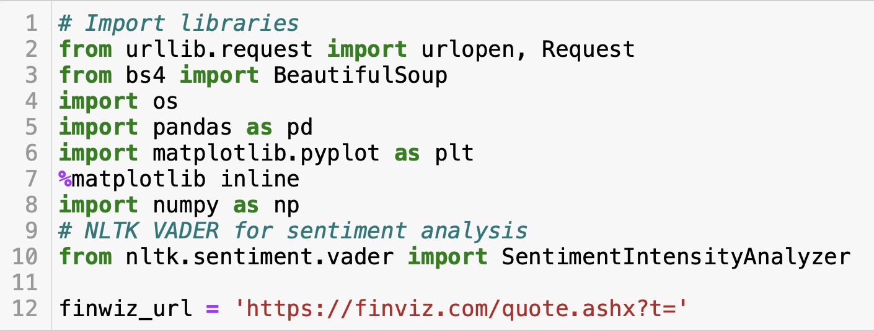
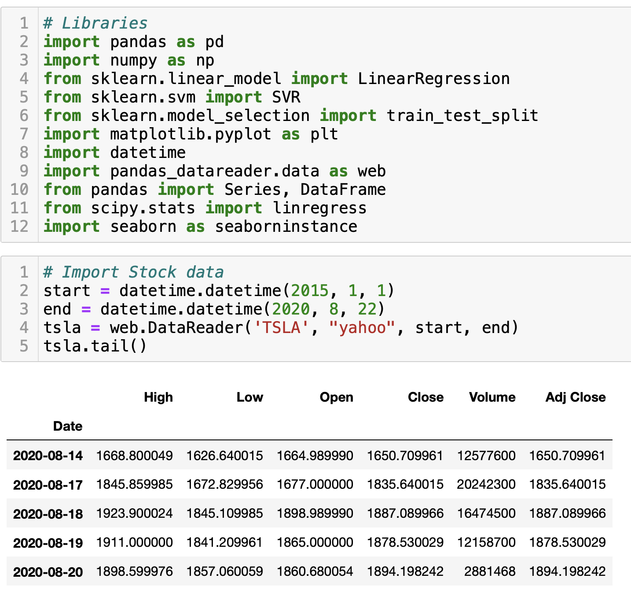
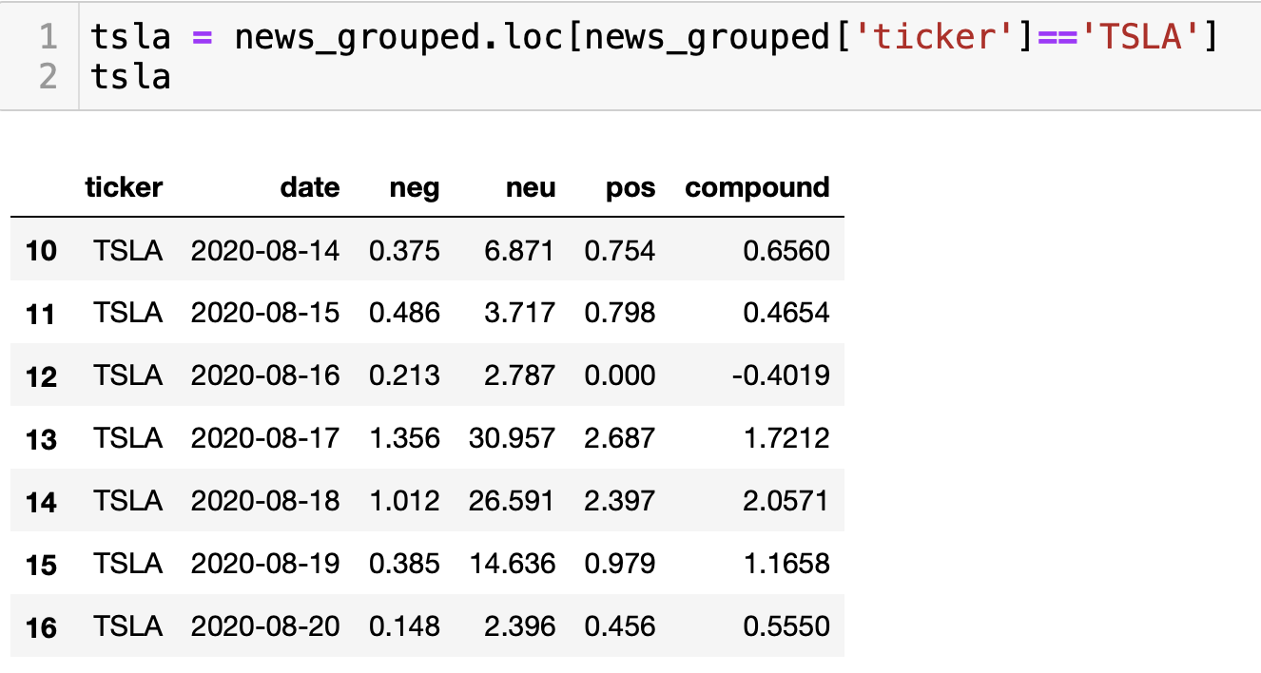
Code Snippets
Sentimental Analysis
Historical Stock Data by Yahoo

Slide 6
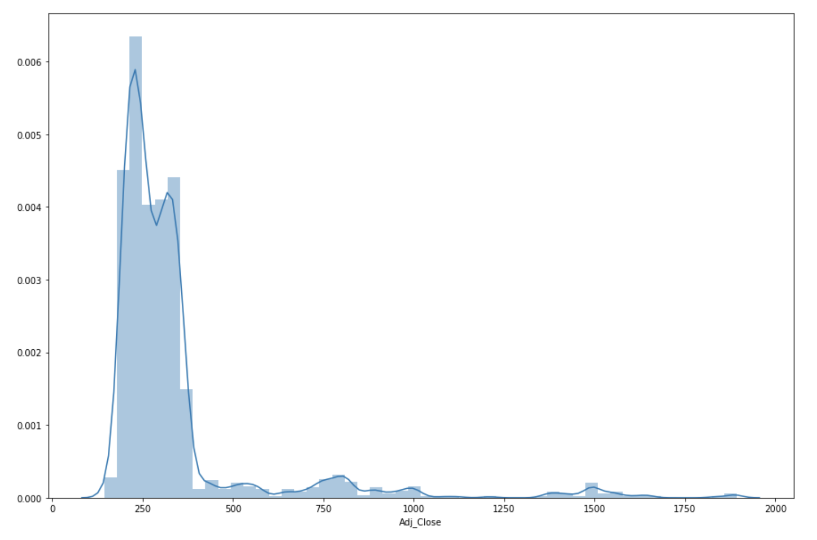
Data Analysis - Average Adjusted Close Price

Slide 7
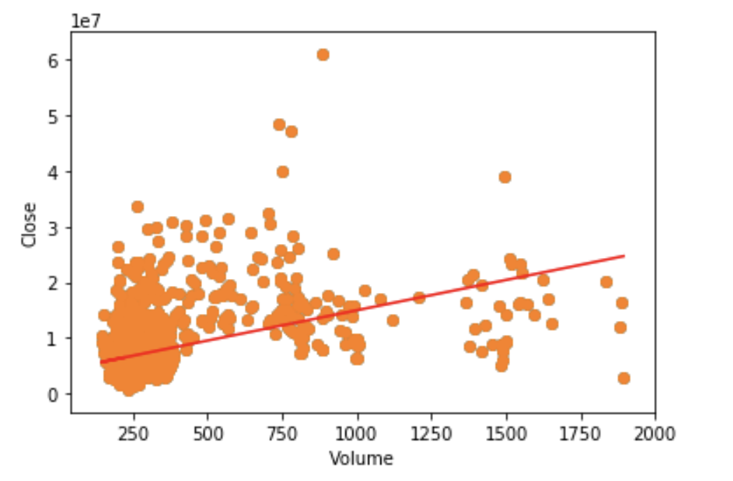
Data Analysis - Correlation

Slide 8
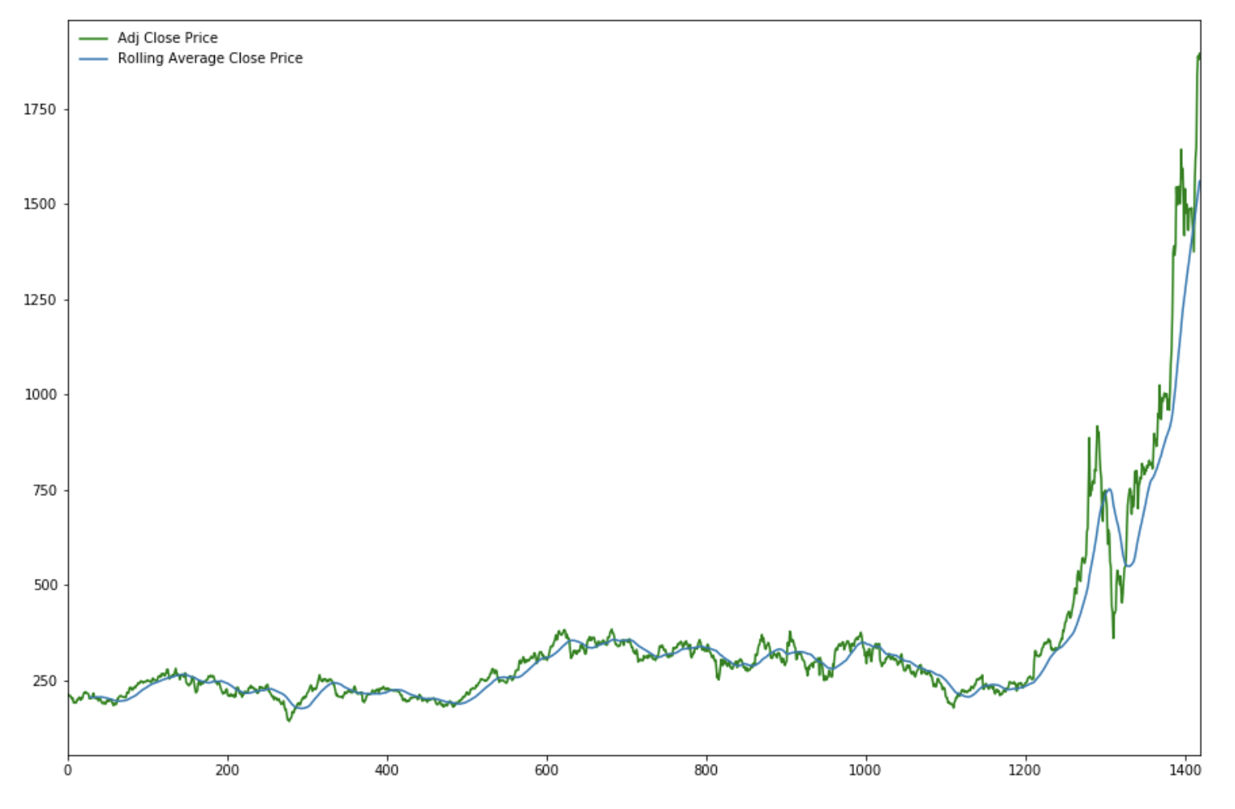
Data Analysis - Rolling Mean Average

Slide 9
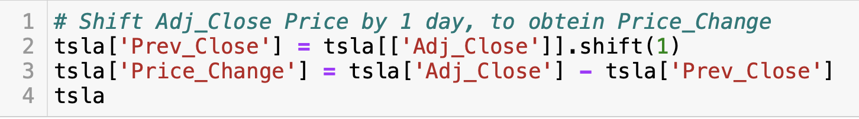
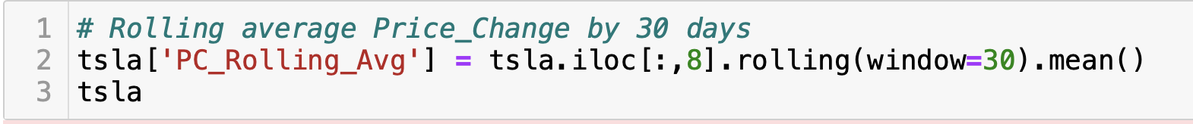
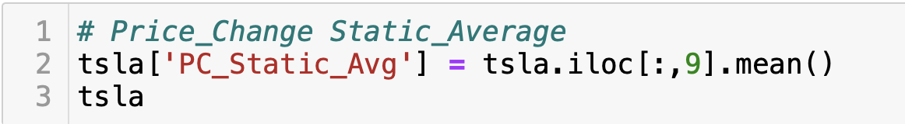
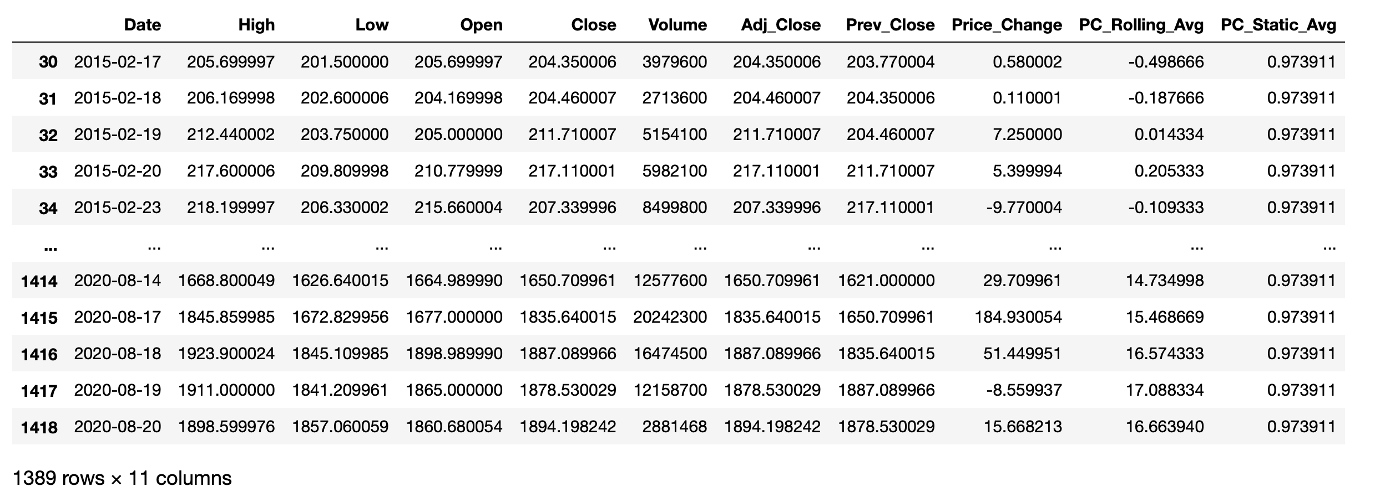
Data Transformation

Slide 10
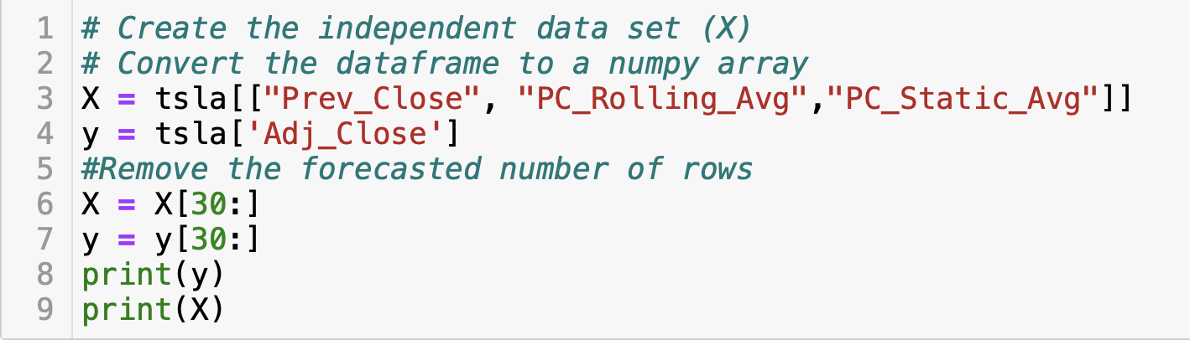

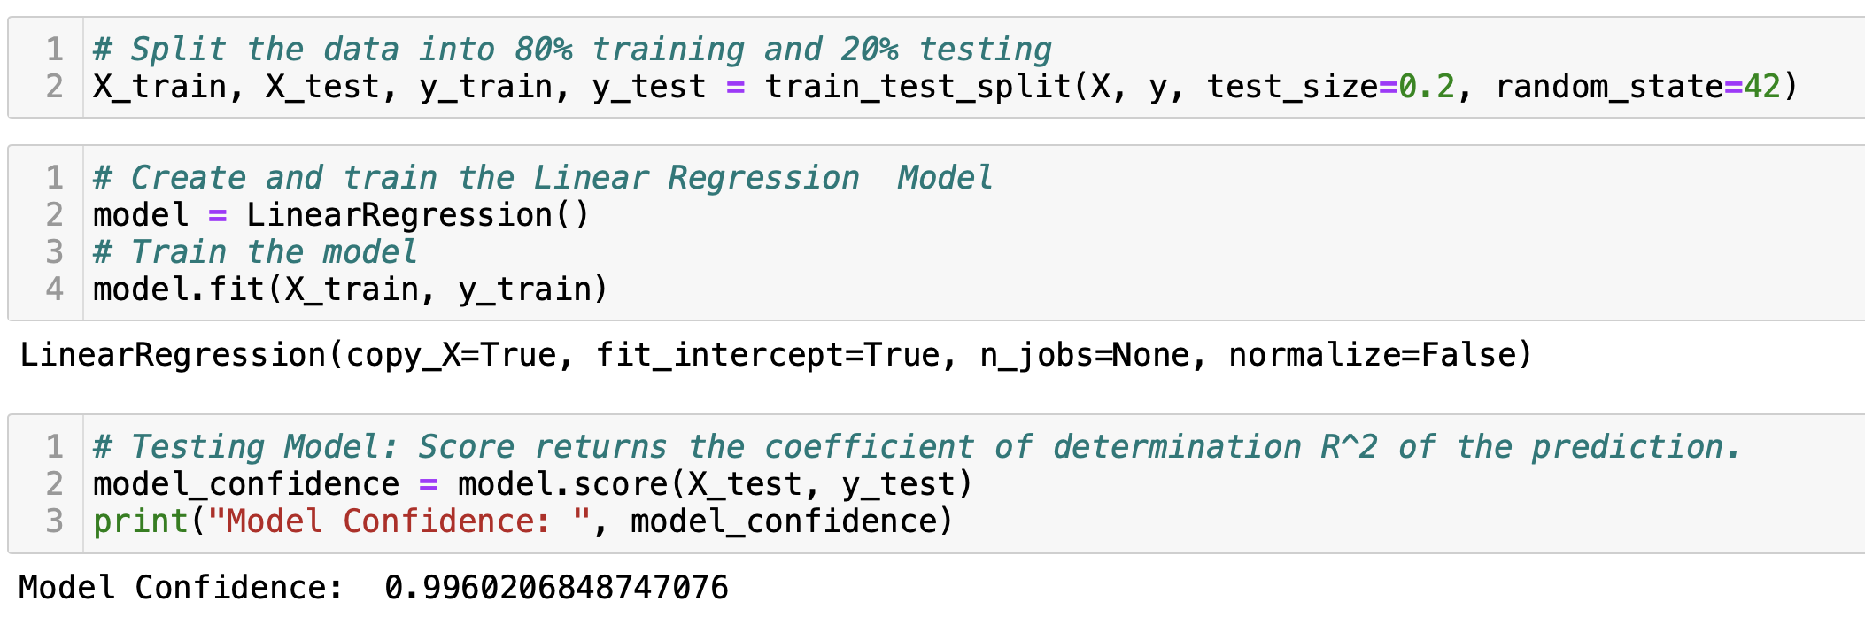
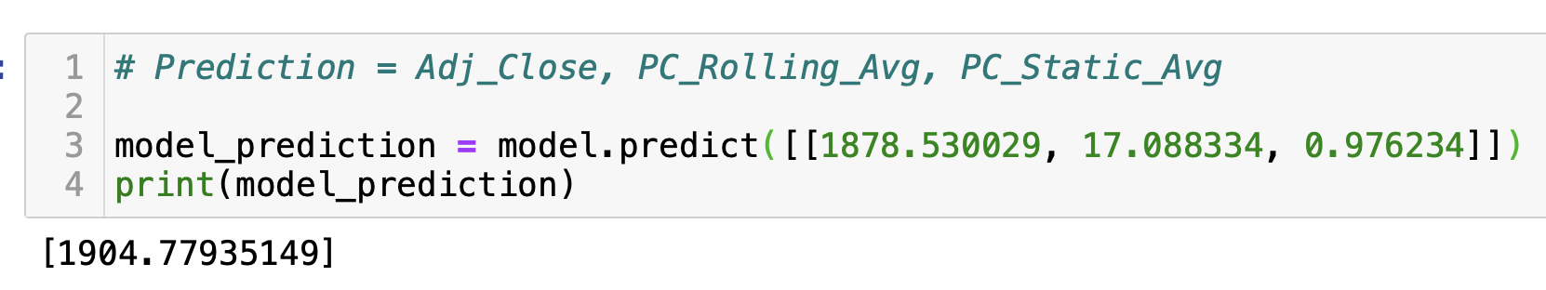
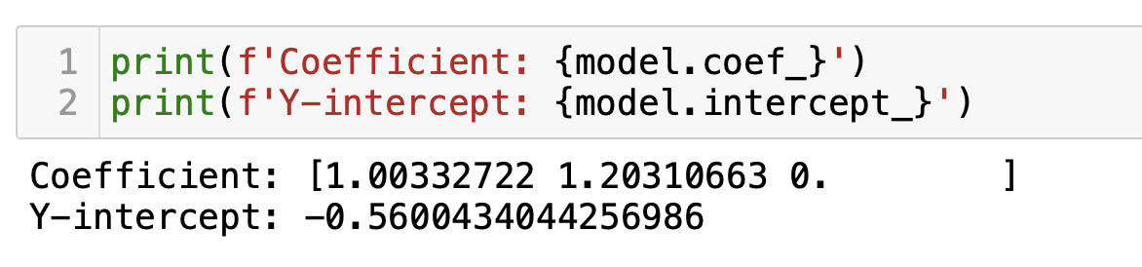
Linear Regression

Slide 11
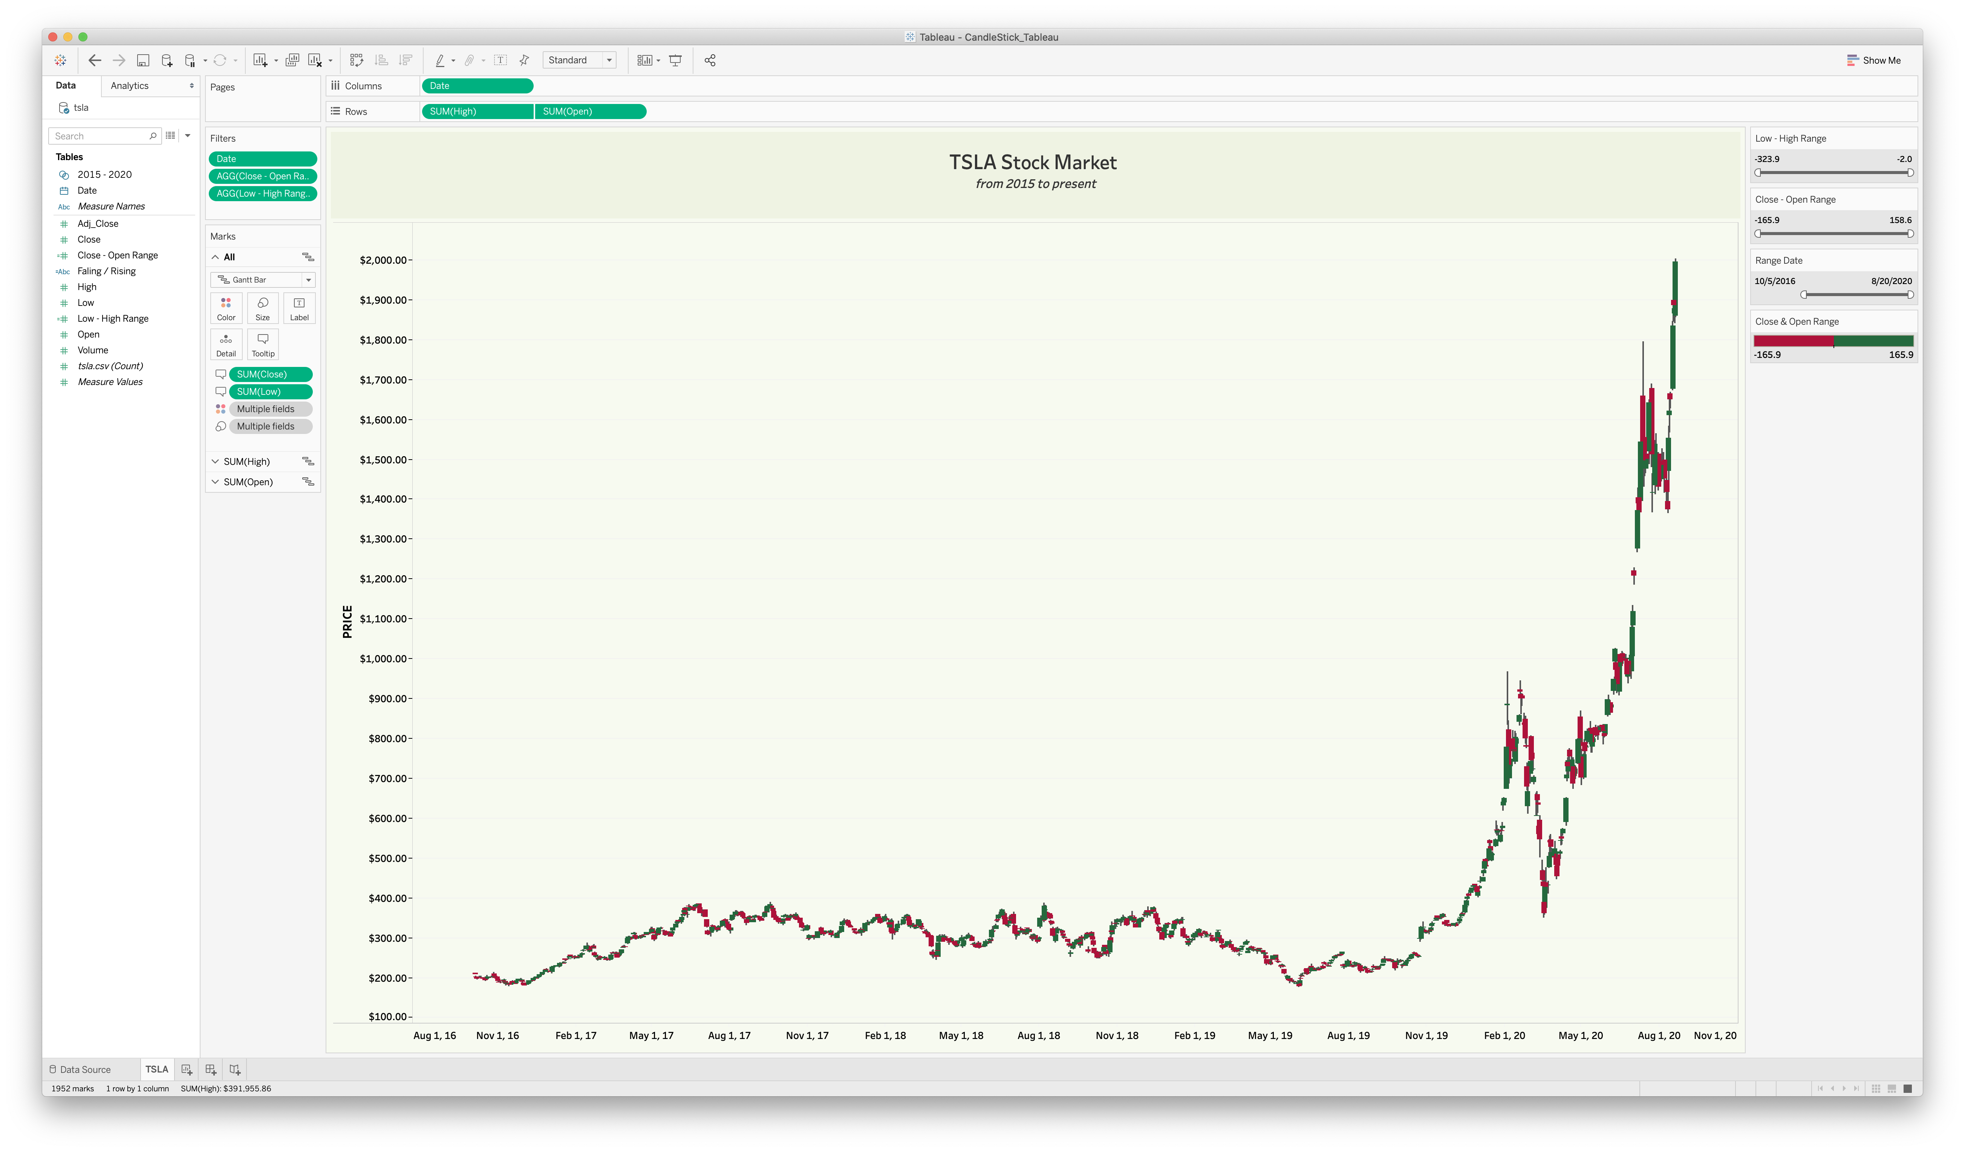
Data Analysis - Candlestick

Slide 12
Conclusion
Tesla stock price is trending upwards based on Machine Learning Analysis and Candlestick analysis.
Stock prices are dependent on various factors that includes but not limited to:
Market changes
Politics
Stock news etc.
Any variance in the stock price prediction can be attributed to stock Sentimental Analysis.
Consideration: Need to incorporate stock sentimental information as part of the regression analysis to obtain accurate model.
Stock market prices are highly unpredictable and volatile. Use your own knowledge & judgment before purchasing a stock.

Slide 13
References
https://towardsdatascience.com/sentiment-analysis-of-stocks-from-financial-news-using-python-82ebdcefb638https://finance.yahoo.com/quote/TSLA?p=TSLA&.tsrc=fin-srch
https://www.nltk.org
https://programminghistorian.org/en/lessons/sentiment-analysis
https://www.investopedia.com/trading/candlestick-charting-what-is-it/
https://kb.tableau.com/articles/howto/creating-a-candlestick-chart
https://www.youtube.com/watch?v=sJCgnSOcTPE
https://www.youtube.com/watch?v=jmoOrgTP5XQ
Steven Will – guidance and inputs.

Slide 14
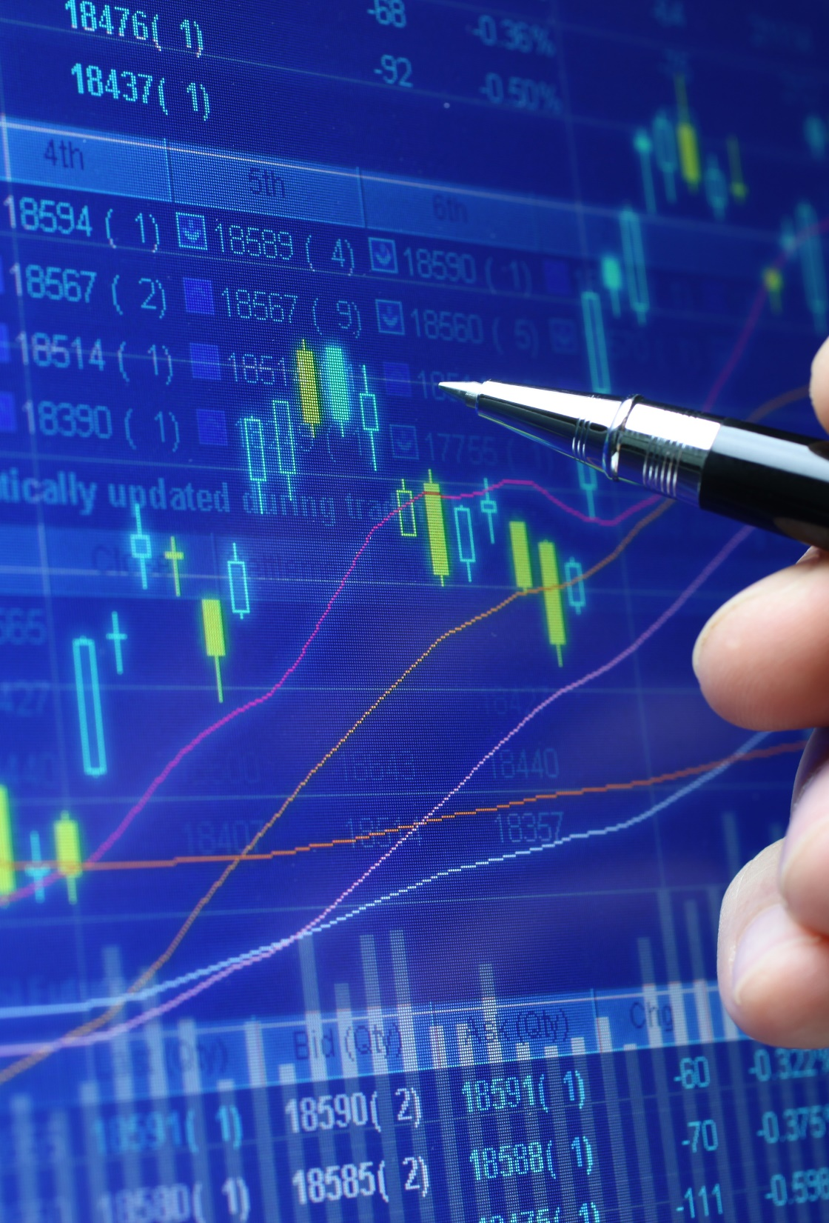
Thank you
Questions?

